Slide 1

Pour Another Cup of Data
By Owen Telis, Randy Kohila, Isaiah Sarria, Michael Farrelly

Slide 2

Data Set
Our data set is from National Institute on Alcohol Abuse and Alcoholism.
This data set is a surveillance report on 1977–2016 apparent per capita alcohol consumption in the United States is the 37th in a series of consumption reports produced annually by the National Institute on Alcohol Abuse and Alcoholism (NIAAA).

Slide 3

Reason for Dataset
We chose this dataset because we thought it would be a fun insight into the change in drinking amount per capita in the US over time.
We decided to use various forecasting methods to find our conclusion.

Slide 4

First Steps
Our data set needed to be cleaned up. We achieved this by merging the data to consolidate it into a nationwide data set as it was originally alcohol consumption by state.

Slide 5
Data Exploration
After having the data frame of consolidated alcohol consumption, we began forecasting the time frame of 2010 to 2016. Once we had the results of our forecast, we compared our models against the actual values.

Slide 6
Methodology
The first forecasting technique used was exponential moving average. (EMA).
The second forecasting technique used was exponential smoothing.
The third forecasting technique used was linear regression.

Slide 7

Error Techniques
We used MAD, MSE, and MAPE to find the error values on our forecast to determine which forecast was more accurate and the best choice.

Slide 8
Findings
By comparing the actual values against our six-year forecast we found:
that exponential moving average was the most accurate forecasting technique.
This was found by comparing the other forecasting techniques and their MAD, MSE, and MAPE error values.
We found that EMA had the lowest MSE error value.

Slide 9
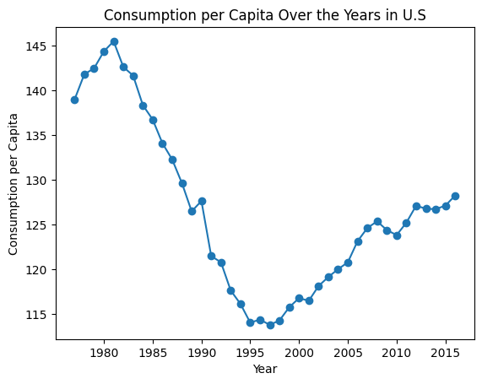
Figure 1: This chart shows the consumption of alcohol from 1977-2016. It starts at a high peak, declines and then begins to start an incline trend.

Slide 10
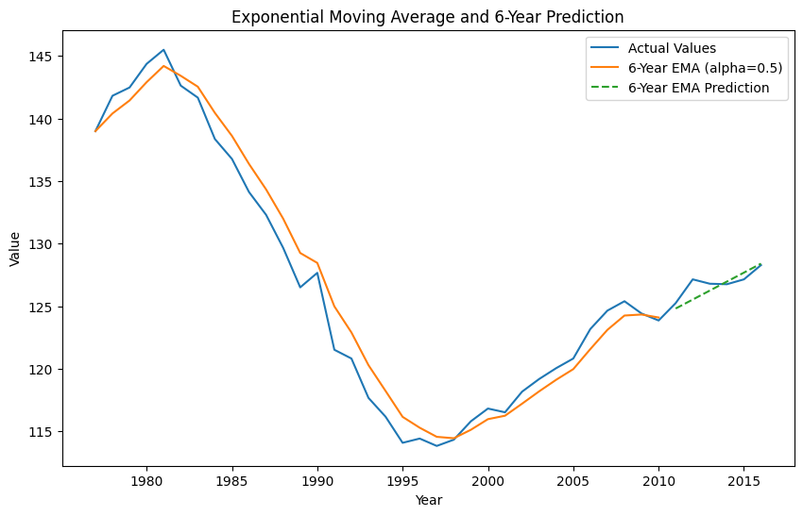
Figure 2: This chart shows the EMA and a 6-Year-Predition. We chose a close-fitting alpha value, and we were cautious to not overfit.

Slide 11
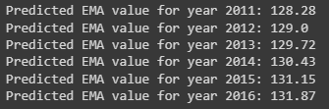
Figure 3
These are the six values it predicts using the exponential moving average forecast and an alpha value of 0.5.

Slide 12
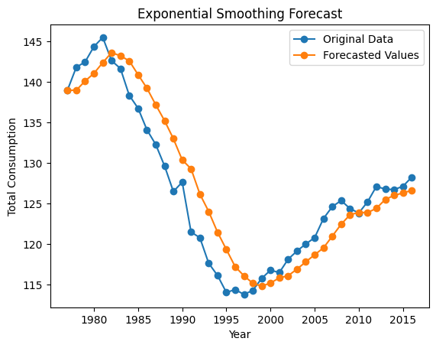
Figure 4
This chart shows the Exponential Smoothing Forecast.

Slide 13
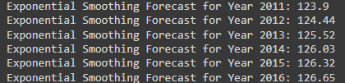
Figure 5
These are the six values it predicts using the exponential smoothing forecast.

Slide 14
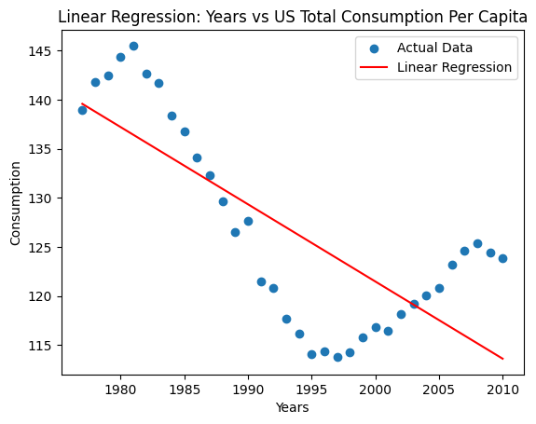
Figure 6
This chart shows the Linear Regression Forecast.

Slide 15
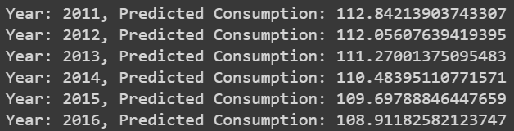
Figure 7
These are the six values it predicts using the linear regression forecast. Also, here is the regression equation.

Slide 16
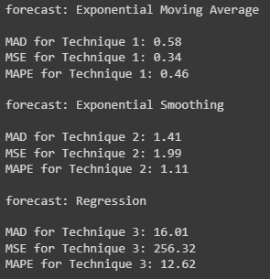
Figure 8
Here are the error estimators MSE, MAD, MAPE that were printed from our code.

Slide 17
Thank you.

